Slide 1
6
0
240
=
4
3
X
+
18
+
258

Slide 2
8
0
400
=
5
3
X
+
24
+
424

Slide 3
(80-2)
7
78
=546
(60-3)
57
=399
X
(80+6)
86
=602
62
=434
(60+2)

Slide 4
72
X
(10+1)
11
=792
97
X
17
=1649
(100-3)
(20+1)
36
X
21
=756
88
X
99
=8712
(100-1)

Slide 5
101 X 12
= 1212
1001 X 123
= 123123
10001 X 1234
= 12341234

Slide 6
2468448 X 5
720812568 X 25
40888324864 X 125

Slide 7



Slide 8
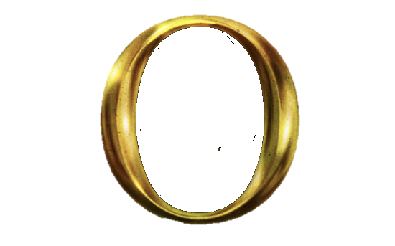
124 X
1
=
5
620
2

Slide 9
36 X
1
=
25
900
4

Slide 10
24
X125
=
3000
8

Slide 11
2468448 X 5
= 1234224
720812568 X 25
= 180203142
40888324864 X 125
= 5111040608

Slide 12
25 X
11
=
2
7
5
2+5

Slide 13
8040 X 275
= 2211
75 X 58 X 44
= 1914
22 X 6 X 50.5
= 6666

Slide 14

As a finale, let’s do a

Slide 15
1² =
1
6² =
36
11² =
121
16² =
256
21² =
441
2² =
4
7² =
49
12² =
144
17² =
289
22² =
484
625
484
441
576
400
121
100
64
81
144
169
529
225
196
361
16
4
1
256
9
324
289
25
36
49
3² =
9
8² =
64
13² =
169
18² =
324
23² =
529
4² =
16
9² =
81
14² =
196
19² =
361
24² =
576
5² =
25
10² =
100
15² =
225
20² =
400
25² =
625
5²
7²
4²
9²
25²
19²
12²
14²
13²
2²
23²
1²
18²
15²
20²
16²
17²
10²
6²
3²
11²
22²
8²
21²
24²

Slide 16
1² =
1
6² =
36
11² =
121
16² =
256
21² =
441
2² =
4
7² =
49
12² =
144
17² =
289
22² =
484
3² =
9
8² =
64
13² =
169
18² =
324
23² =
529
4² =
16
9² =
81
14² =
196
19² =
361
24² =
576
5² =
25
10² =
100
15² =
225
20² =
400
25² =
625

